Slide 1
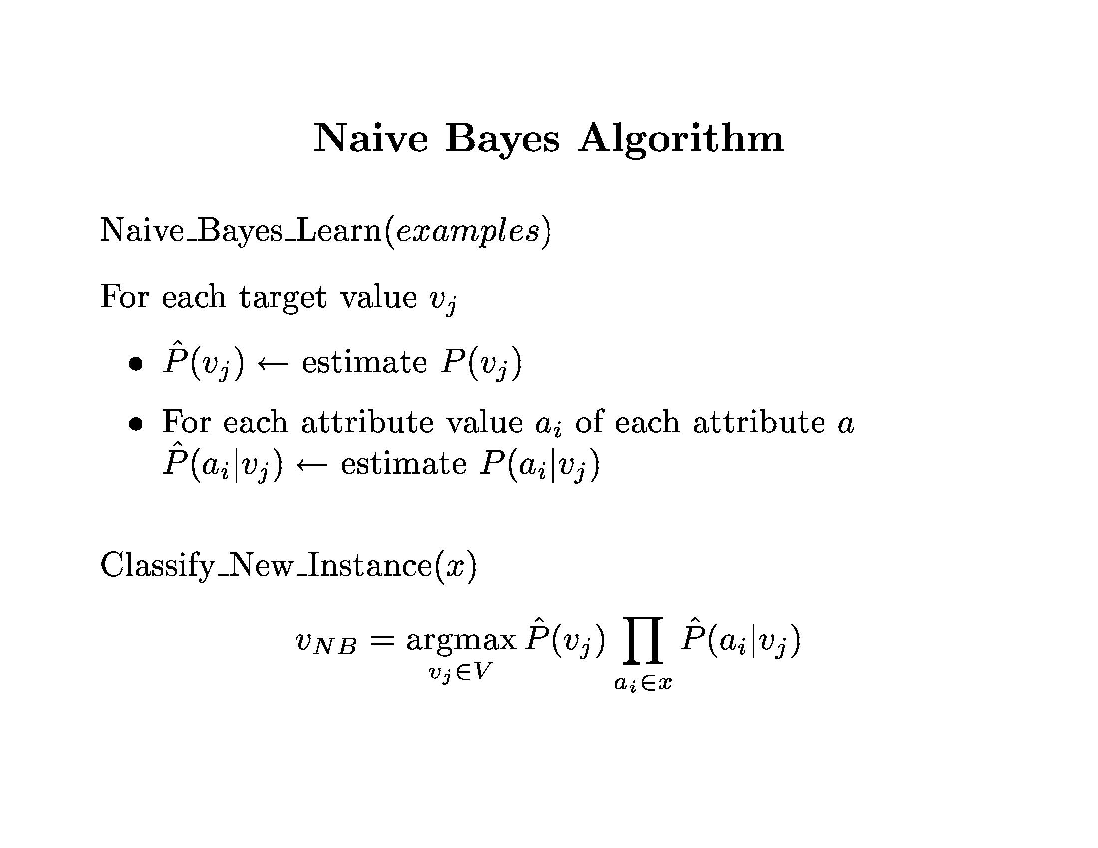

Slide 2
Given a training set, we can compute the probabilities

Slide 3
An unseen sample X = <rain, hot, high, false>
P(X|p)·P(p) = P(rain|p)·P(hot|p)·P(high|p)·P(false|p)·P(p) = 3/9·2/9·3/9·6/9·9/14 = 0.010582
P(X|n)·P(n) = P(rain|n)·P(hot|n)·P(high|n)·P(false|n)·P(n) = 2/5·2/5·4/5·2/5·5/14 = 0.018286
Sample X is classified in class n (don’t play)

Slide 4
The Naive Bayes Classifier for Data Sets with Numerical Attribute Values
One common practice to handle numerical attribute values is to assume normal distributions for numerical attributes.

Slide 5
Let x₁, x₂, …, x_{n} be the values of a numerical attribute in the training data set.

Slide 6
Naive Bayes
Example: Continuous-valued Features
Temperature is naturally of continuous value.
Yes: 25.2, 19.3, 18.5, 21.7, 20.1, 24.3, 22.8, 23.1, 19.8
No: 27.3, 30.1, 17.4, 29.5, 15.1
Estimate mean and variance for each class
Learning Phase: output two Gaussian models for P(temp|C)

Slide 7
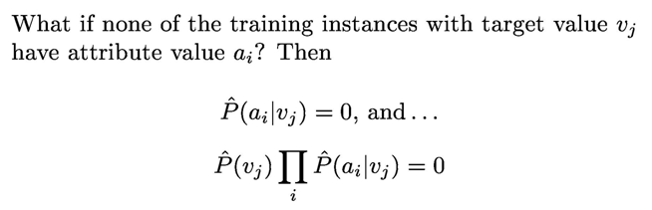
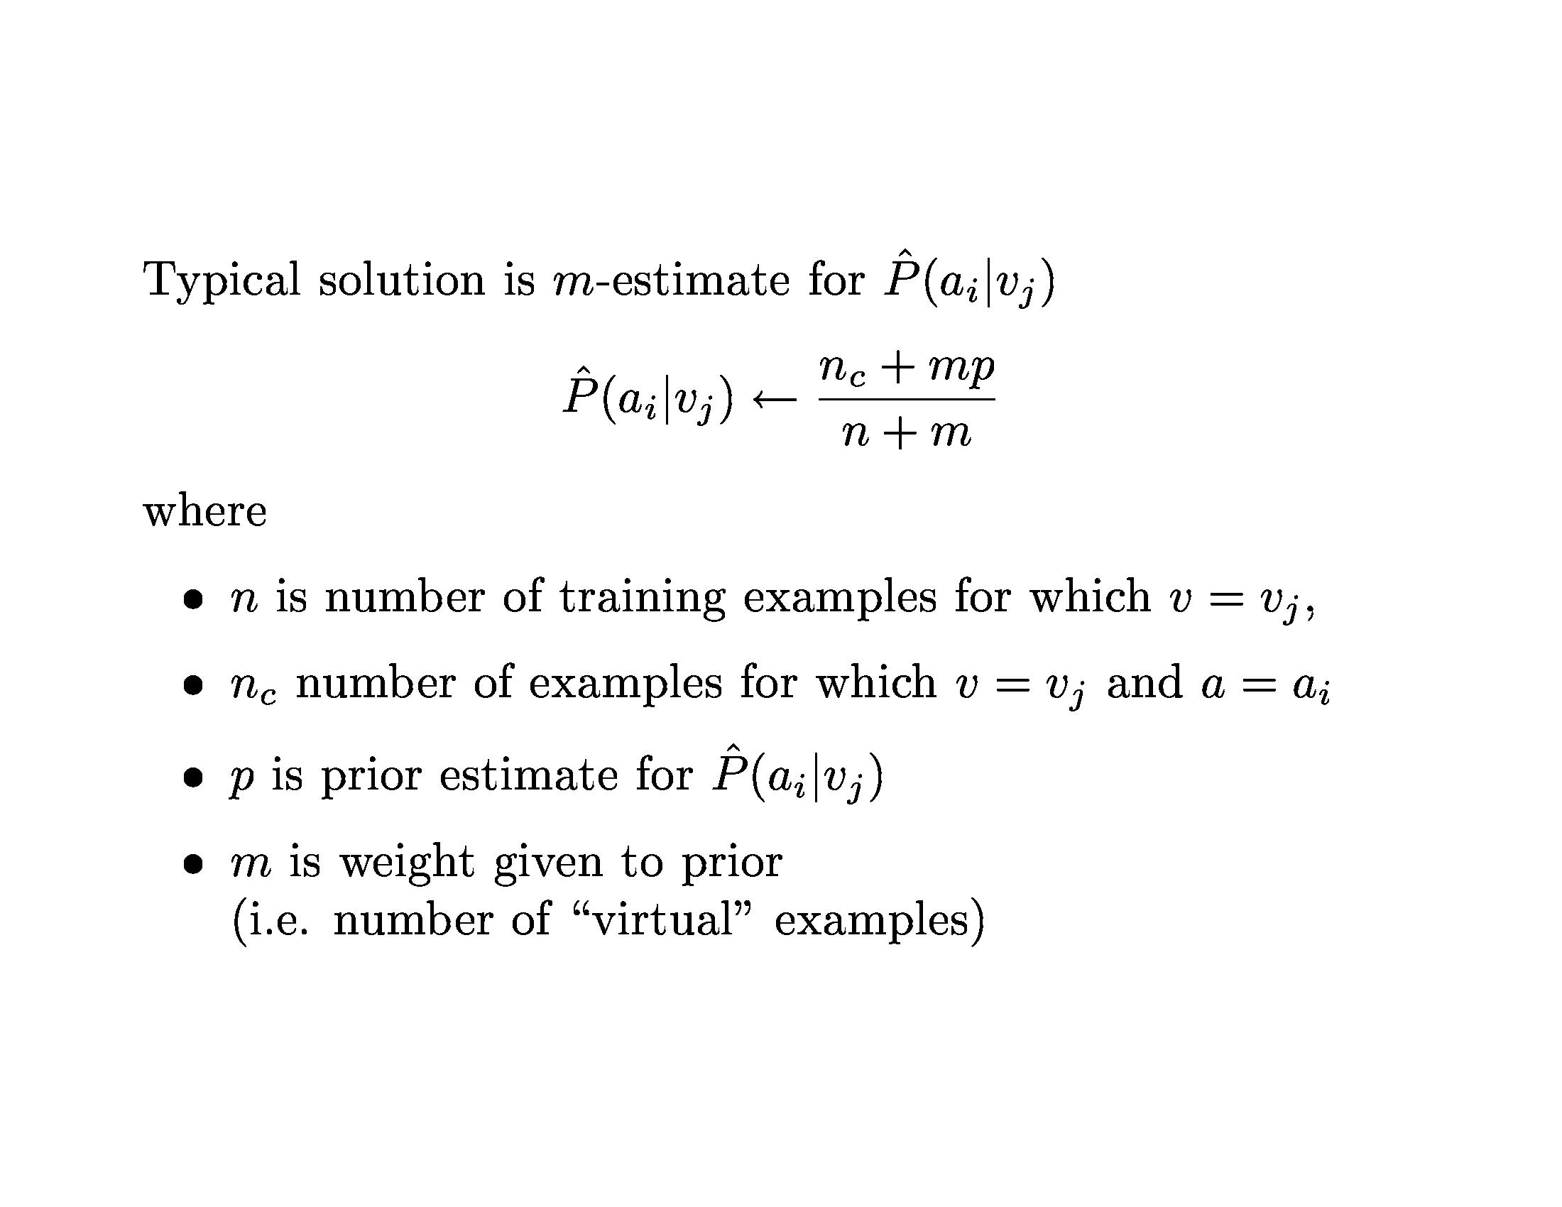

Slide 8
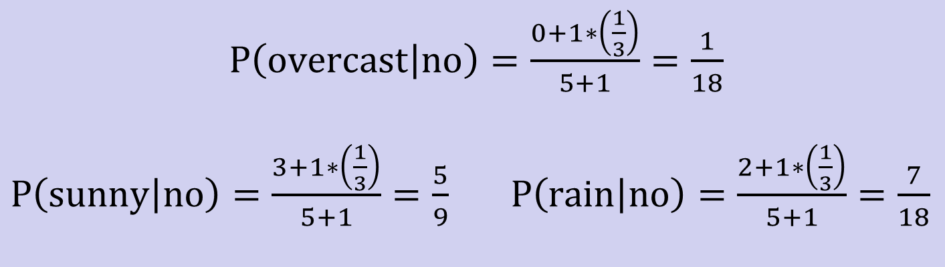
Example: P(outlook=overcast|no)=0 in the play-tennis dataset
Adding m “virtual” examples (m: up to 1% of #training example)
In this dataset, # of training examples for the “no” class is 5.
We can only add m=1 “virtual” example in our m-esitmate remedy.
The “outlook” feature can takes only 3 values. So p=1/3.
Re-estimate P(outlook|no) with the m-estimate

Slide 9
How about Linear-Loss ?
Linear-Loss Function
Fitting Error Grows Linearly

Slide 10
You are given some documents, each specified by a feature vector, (X1, X2, X3), where each component has a binary value. There are two possible classifications of a document, C = 0 or 1. It is 3 times more likely that a document is in class 1 than in class 0. You also know:
P(X1 = 1 | C = 0) =0.25, P(X2 = 1 | C = 0) = 0.5, P(X3 = 1 | C = 0) = 0.4, P(X1 = 1 | C = 1) = 0.5, P(X2 = 1 | C = 1) =0.25, and P(X3 = 1 | C = 1) = 0.3.
Given a new document with feature vector (X1 = 0, X2 = 1, X3 = 1), determine the classification of this document using the Naive Bayes model.
P(011 | C = 0) = (. 75)(0. 5)(0. 4)(0. 25) = 0. 0375
P(011 | C = 1) = (0. 5)(0. 25)(. 3)(0. 75) = 0. 028

Slide 11
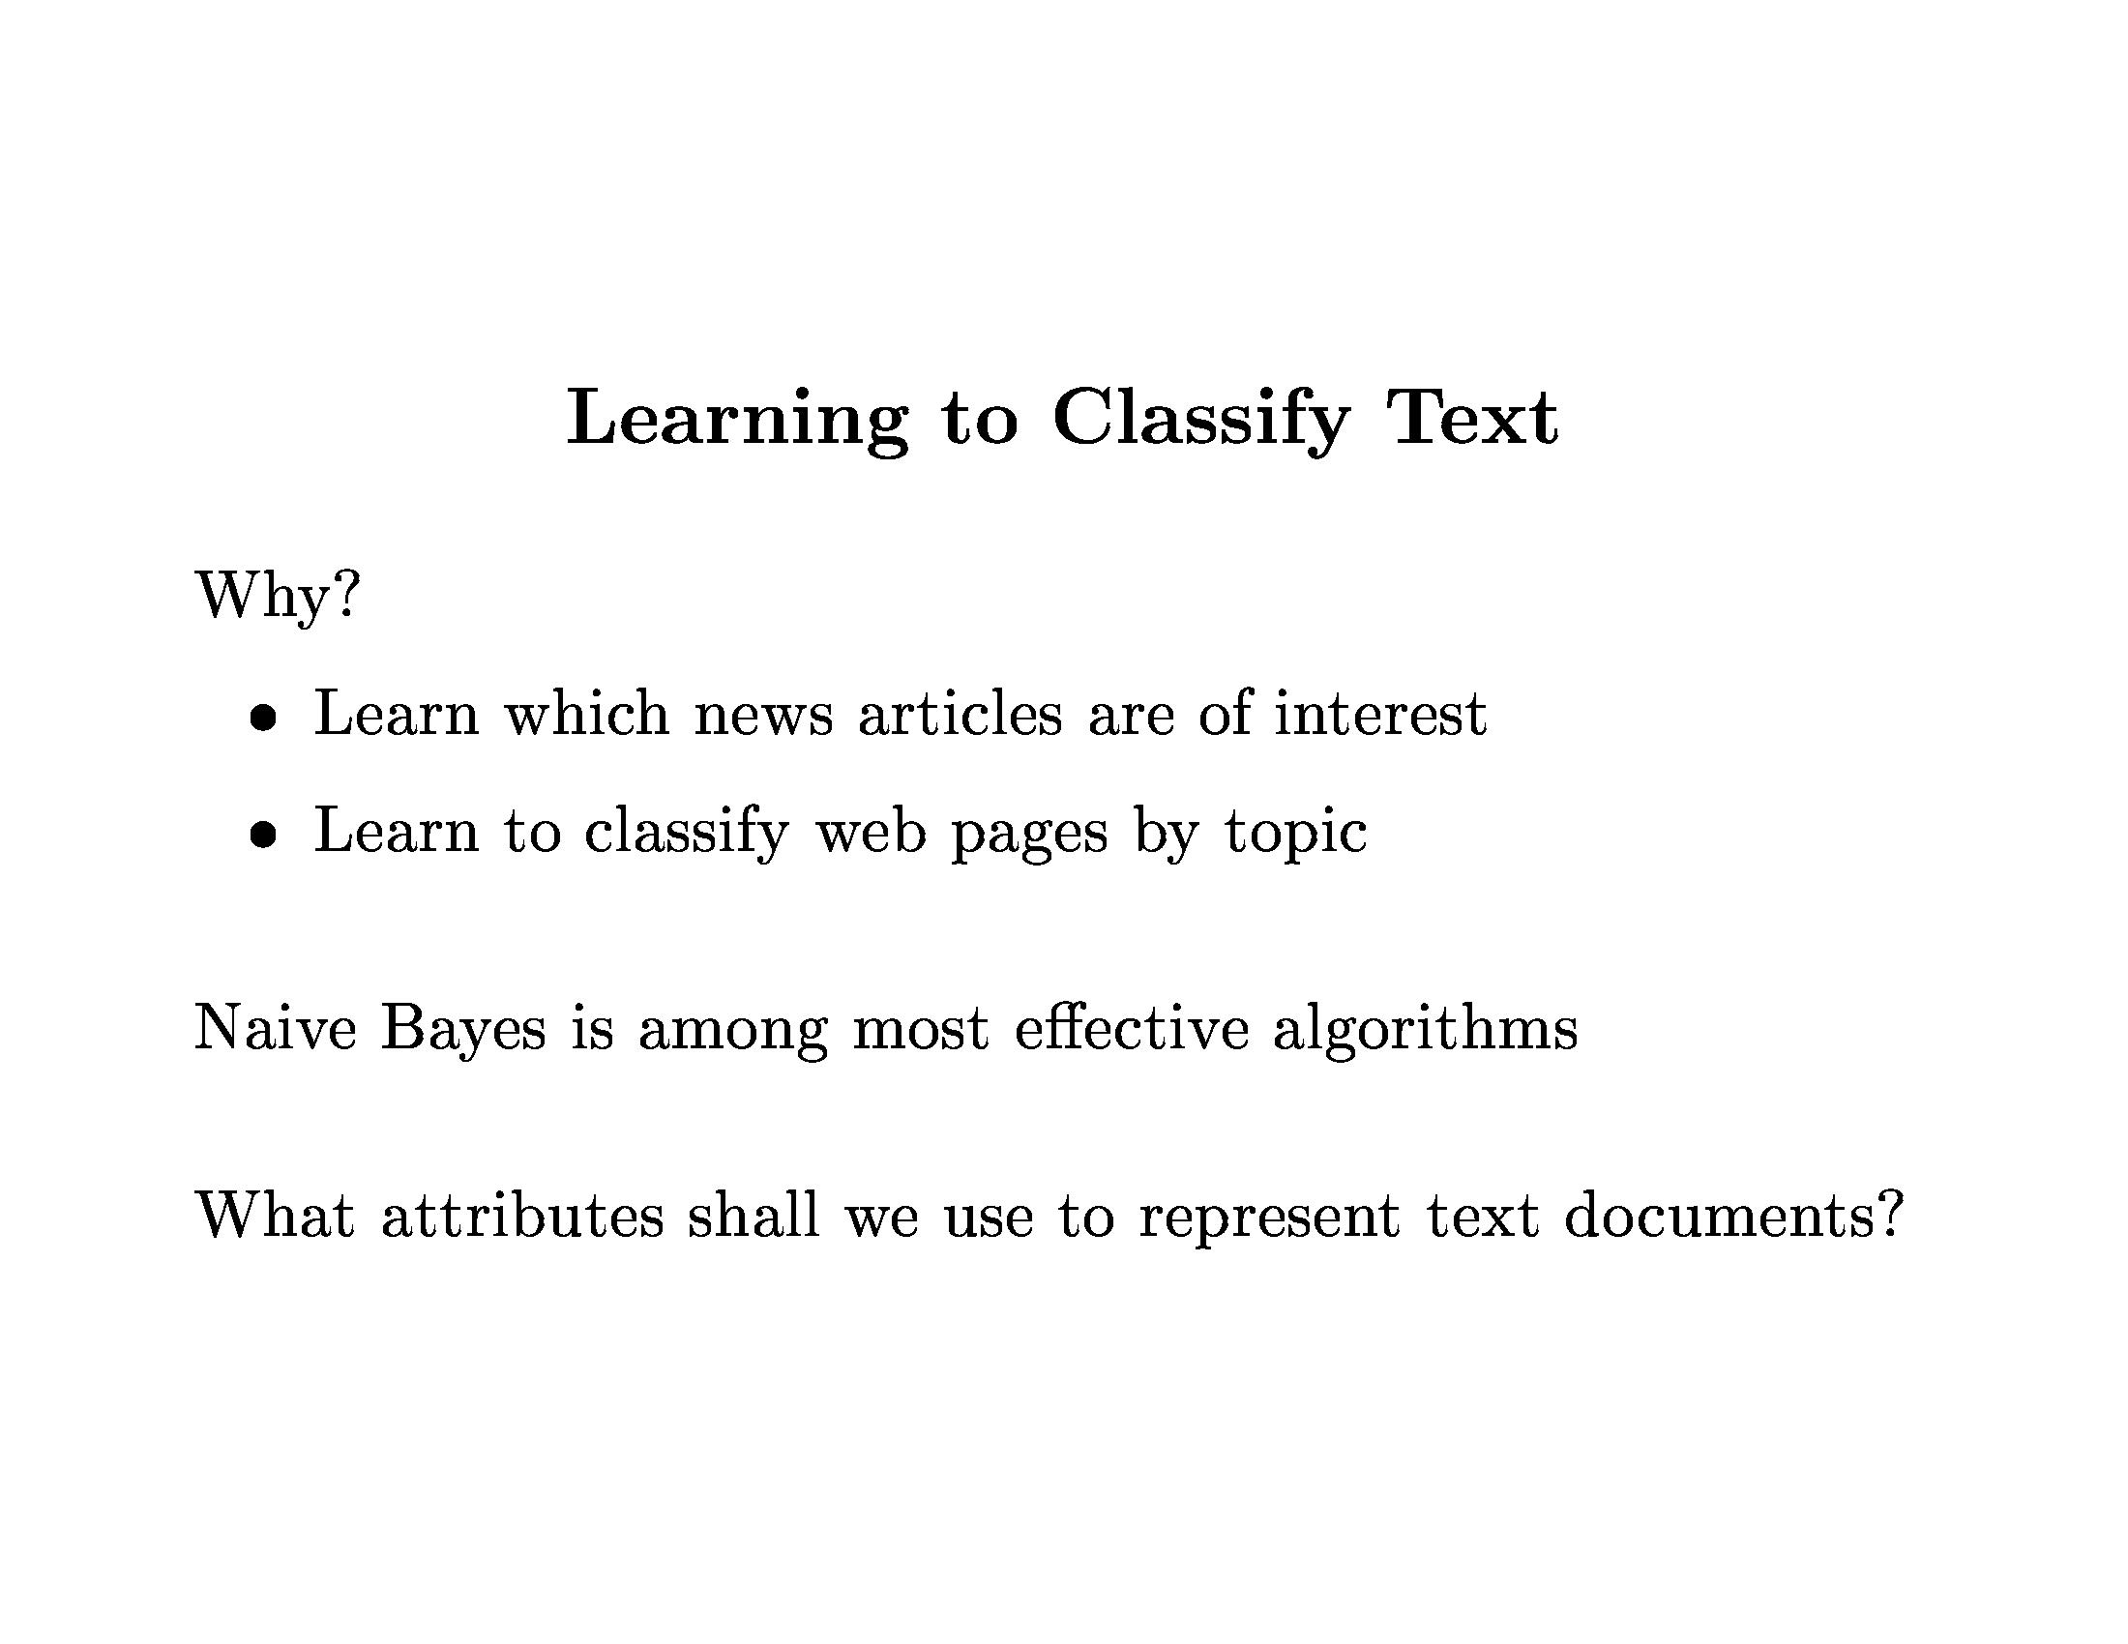

Slide 12
EXAMPLES OF TEXT CATEGORIZATION
LABELS=BINARY
“spam” / “not spam”
LABELS=TOPICS
“finance” / “sports” / “asia”
LABELS=OPINION
“like” / “hate” / “neutral”
LABELS=AUTHOR
“Shakespeare” / “Tagore” /

Slide 13
Text Classification: Examples
LABELS=BINARY
“spam” / “not spam”
LABELS=TOPICS
“finance” / “sports” / “asia”
LABELS=OPINION
“like” / “hate” / “neutral”
LABELS=AUTHOR
“Shakespeare” / “Tagore”

Slide 14
Text Classification: Examples
Classify news stories as World, US, Business, SciTech, Sports, Entertainment, Health, Other
Classify business names by industry.
Classify student essays as A,B,C,D, or F.
Classify email as Spam, Other.
Classify email to tech staff as Mac, Windows, ..., Other.
Classify pdf files as ResearchPaper, Other
Classify documents as WrittenByReagan, GhostWritten
Classify movie reviews as Favorable,Unfavorable,Neutral.
Classify technical papers as Interesting, Uninteresting.
Classify jokes as Funny, NotFunny.

Slide 15
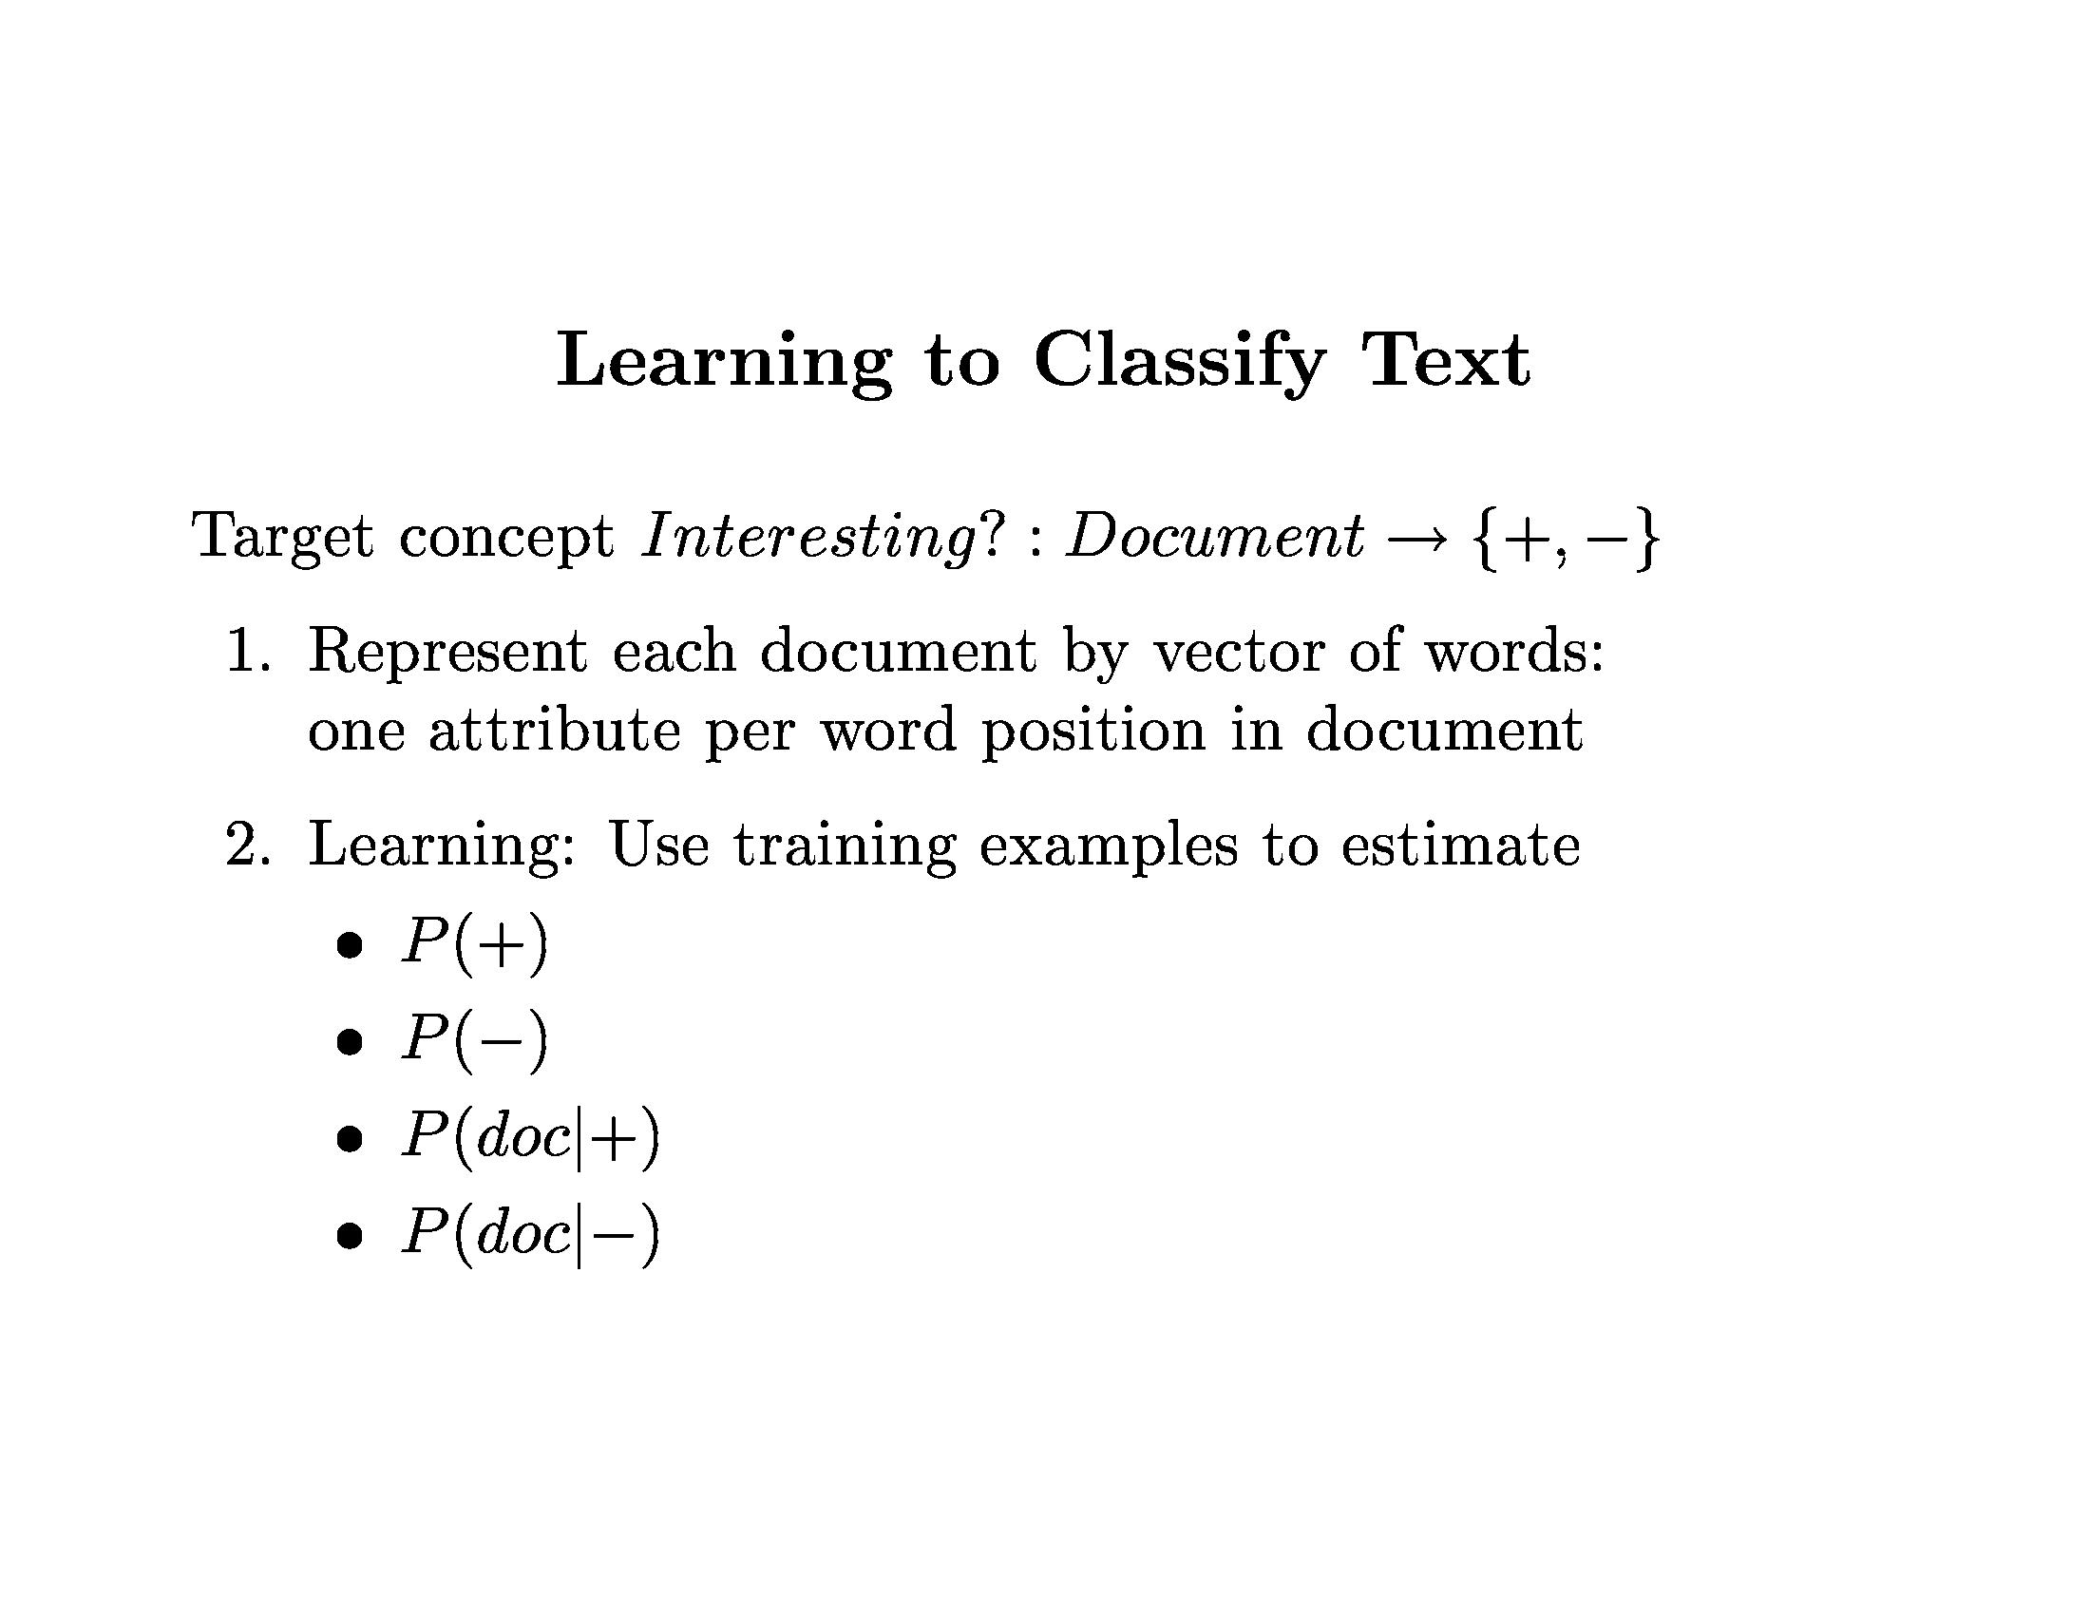

Slide 16
General setting: Consider an instance space X consisting of all possible text documents. Given are training samples of some unknown target functions.
A TEXT DOCUMENT
Now the idea of Pakoda is being hailed as Modi government's single biggest contribution to India. India did not vote for the BJP in 2014 to buy more pakodas or see more and more youth set up corner stalls for frying fritters, boiling eggs or serving pani puri. The vote was for better days, more employment, high rates of growth, and ultimately, a life of dignity and hope. With its reductive pakoda logic, the BJP is only hiding its failure. Also, what exactly is the government's contribution if a youth sets up a roadside stall, buys a stove, oil, condiments and some gram flour to earn a living? It is in fact a desperate measure that signals the end of hopes and dreams, a surrender to circumstances. Any government that claims credit for this is just laughing at itself.

Slide 17
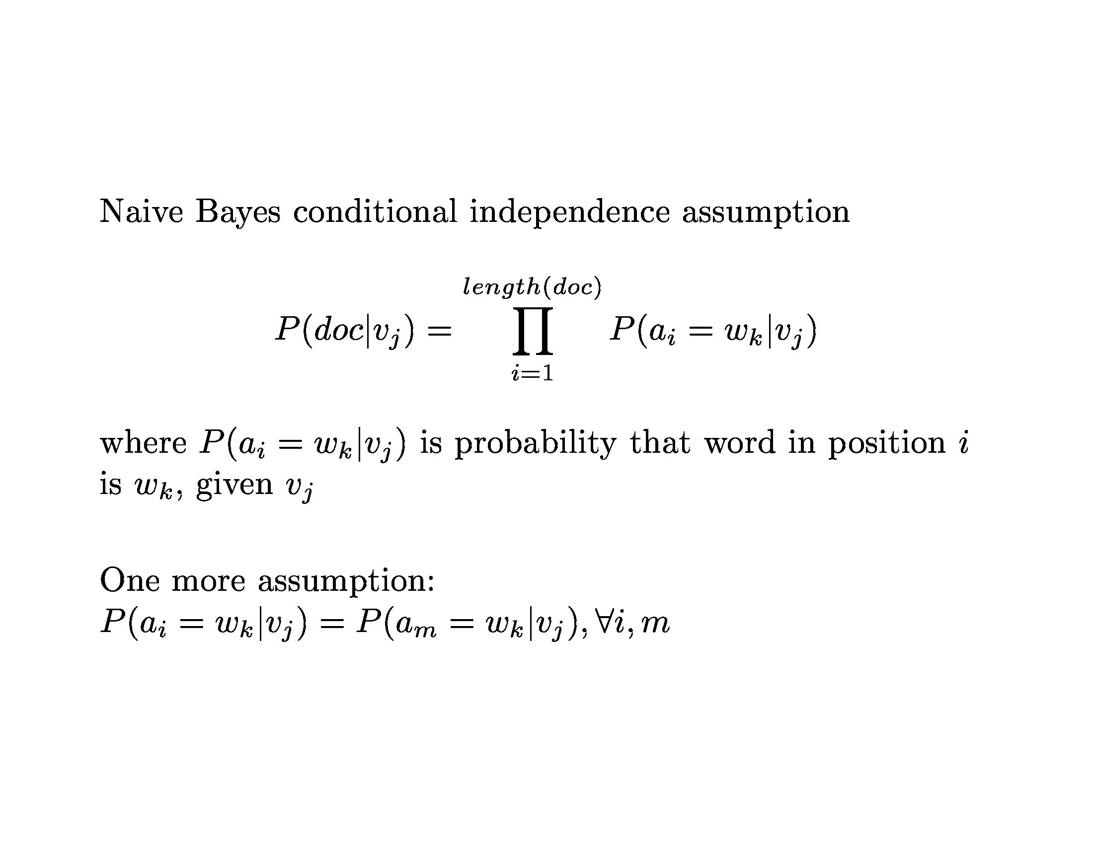

Slide 18
The NB classification is the classification that maximizes the probability of observing the words that were actually found in the document, subject to the independence assumption.
Assumption: The word probabilties of one text position are independent of the words that occur in other positions, given the document classification vj.
In practice, NB performs remarkably well in many text classification problems despite the independence assumption [1]
50000 distinct words 2 possible target values 111 text positions
10 million terms.
Assume that the probability of encountering a specific word wk is independent of the specific word position being considered. 100,000 terms
n total number of word positions in all training examples whose target value is vj
nk= the number of times word wk is found among these n word positions.

Slide 19
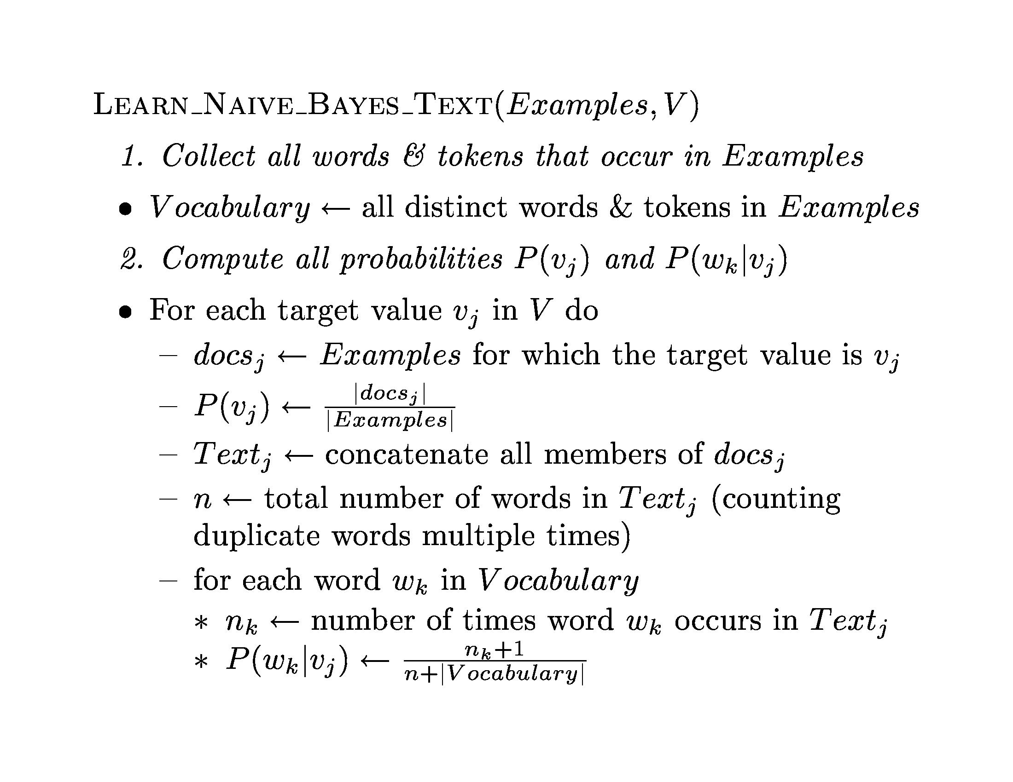

Slide 20
[1]
homes.cs.washington.edu/~pedrod/papers/mlc96.pdf
Code and data
http://www.cs.cmu.edu/afs/cs/project/theo-11/www/naive-bayes.html
https://www.cs.cornell.edu/people/tj/publications/joachims_97a.pdf

